Slide 1
History of Forensic Science

Slide 2
Major Developments in the History of Forensic Science
  700 AD: Chinese used fingerprints to establish identity of documents and clay sculptures.
  1000: Roman courts determined that bloody palm prints were used to frame a man in his brother’s murder.
  1149: King Richard of England introduced the idea of the coroner to investigate questionable deaths.
  1248: A murder in China was solved when flies were attracted to invisible blood residue on the sword of a man in the community.
  1514: Earliest known use of blood spatter evidence.
  1598: Fidelus was first to practice forensic medicine in Italy.
  1668: analysis of blowfly infestation of rotting meat allows Francesco Redi to refute the hypothesis of “spontaneous generation” of maggots

Slide 3
Major Developments in the History of Forensic Science, continued
  1670: Anton Van Leeuwenhoek constructed the first high-powered microscope.
  1776: Paul Revere identified the body of General Joseph Warren based on the false teeth he had made for him.
  1784: John Toms was convicted of murder on the basis of the torn edge of a wad of paper in a pistol matching a piece of paper in his pocket.
  1810: First recorded use of questioned document analysis involving chemical test for a particular dye
  1816: A farm laborer is convicted of murder based upon impression evidence
  1840: Forensic toxicology is first used to convict Marie Lafarge, by use of the March test (detects arsenic compounds), of poisoning her husband.
  1856: Herschel uses thumbprints on documents to identify workers
  1859: Gustav Kirchhoff and Robert Bunsen developed the science of spectroscopy.

Slide 4
Major Developments in the History of Forensic Science, continued
  1863: The first presumptive test for blood is developed (hydrogen peroxide)
  1864: Crime scene photography developed.
  1879: Alphonse Bertillon developed a system to identify people using particular body measurements.
  1896: Edward Henry developed the first classification system for fingerprint identification.
  1889: Alexandre Lacassagne publishes a text on matching bullets to individual gun barrels
  1900: Karl Landsteiner identified human blood groups.
  1904: Edmond Locard formulated his famous principle, “Every contact leaves a trace.”
  1906: bite mark evidence is first used in an English Court to convict two burglars using teeth marks found in cheese at the scene
  1910: Albert Osborne publishes Questioned Documents
  1920’s: Palaeontologist Gerasimov develops a method to reconstruct facial appearances from skulls

Slide 5
Major Developments in the History of Forensic Science, continued
  1922: Francis Aston developed the mass spectrometer.
  1932: The FBI crime laboratory is created
  1959: James Watson and Francis Crick discovered the DNA double helix.
  1972: The Forensic Anthropology Center (aka “The Body Farm”) is started at the University of Tennessee.
  1975: Federal Rules of Evidence are enacted
  1977: AFIS developed by the FBI; fully automated in 1996.
  1984: Jeffreys developed and used the first DNA tests to be applied to a criminal case.
  1986: The polymerase chain reaction (PCR) is developed to replicate DNA for forensics
  1992: DNA short tandem repeats (STR) are used in forensic DNA analysis
  1998: FBI index of DNA profiles is formed, CODIS (combined DNA Index System)

Slide 6
Forensic Scientists

Slide 7
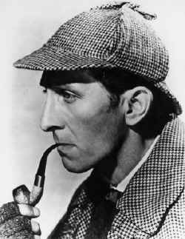
History of Forensic Science
Many people believe that Arthur Conan Doyle was the first to popularize forensic science with his Sherlock Holmes novels. The first, A Study in Scarlet,was published in 1887.

Slide 8
Mathieu Orfila (1787-1853)•
Spanish born but did work in France
Father of Forensic Toxicology
1814 published a Treatise on the detection of poisons

Slide 9
Alphonse Bertillon (1853-1914)
French Scientist
1879 devised first system of person ID using a series of body measurements
Devised the first crime scene kit –still used today

Slide 10
Anthropometry
The Bertillion system relied on a detailed description and measurement of the subject.
Eleven measurements were necessary.
These included height, reach, width of head, and length of foot.

Slide 11
Will West/William West
The down fall of Anthropometry occurred in 1903 at Leavenworth Federal Prison. A prisoner named Will West was brought to the prison and had his measurements taken. His measurements matched a prisoner already in the prison named William West. Despite the system there was no way to tell the two apart. The only noticeable difference between the two men was their fingerprints. Thus Anthropometry was abandoned and the fingerprint (Henry) system was adopted.

Slide 12
Francis) Galton (1822-1911)
British Scientist.
1892 published the book “Finger Prints”which contained the 1ststatistical proof supporting the uniqueness of fingerprints.
Laid the foundation of modern fingerprints.

Slide 13
Karl Landsteiner (1868-1943)
Austrian who immigrated to the U.S.
1901 Discovered human blood could be grouped into different categories (A, B, AB and O).
1930 Won Nobel Prize.
1940 helped to discover the Rh factor in human blood.

Slide 14
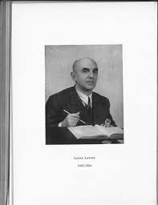
Leone Lattes (1887-1954)
Italian Scientist
1915 devised a procedure by which dried bloodstains could be grouped as A, B, AB or O
His procedure is still used today by some forensic scientists

Slide 15
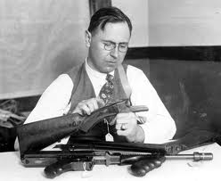
Calvin Goddard (1891-1955)
U.S. Army colonel
Developed the Comparison Microscope
Refined the techniques of determining if a gun had fired a specific bullet. (Ballistics)

Slide 16
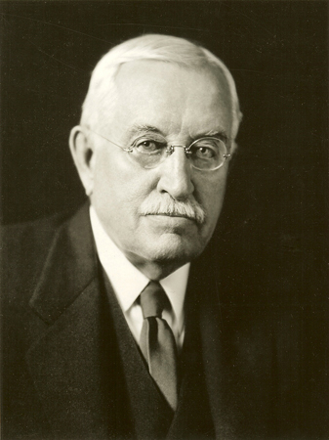
Albert S. Osborn (1858-1946)
American Scientist.
1910 published the book “Questioned Documents.”
The book became a primary reference for document examiners.

Slide 17
Hans Gross (1847-1915)
Lawyer and Judge in Austria
1893 Published the first treatise on applying science to criminal investigation
Started the forensic journal “Kriminologie”

Slide 18
Edmond Locard (1877-1966)
1910 set up the first Forensic Lab in Lyons, France
Founder and Director of the Institute of Criminalistics @ the University of Lyons
Formulated the Locard’s Exchange Principle

Slide 19
Locard’s Exchange Principle
When a criminal comes in contact with an object or person, a cross-transfer of evidence occurs
The criminal either removes something from the crime scene or leaves something behind
Either way this exchange can link the criminal to the crime scene

Slide 20
Paul Kirk (1902-1970)•
U.S. scientist that applied biochemistry to forensics
1950 Head of the Crime Dept @ U of Cal school of Criminology
1953 published “Crime Investigation”,a handbook for lab techniques

Slide 21
J. Edgar Hoover (1895-1972)
Director of the FBI (1924-1972)
FBI was established in 1905 by Teddy Roosevelt as the Bureau of Investigation•1924 National Fingerprint file organized
1932 Crime Lab Established
1935 National Police Academy formed
1935 Bureau renamed FBI

